Slide 1
Making trips safer for students and easier for teachers

Slide 3
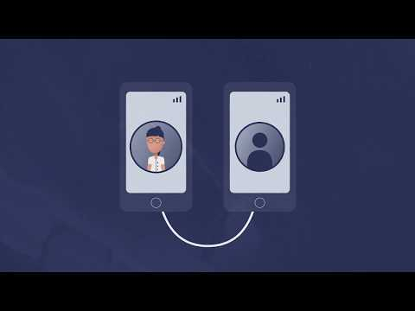

Slide 4
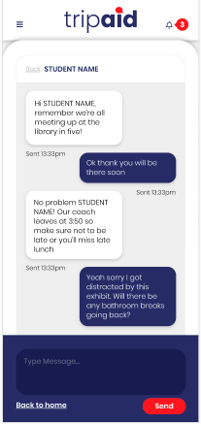
How will TripAid help you on a school trip?
Easy to set up
Message students individually or as a group (push notification)
Locate students
No contact details are shared
You can use your own phone on the trip and no student will ever see your number. You control the group during the trip.
Notes:
It takes minimal effort to set up a messaging group.
Any time you want to communicate with students, you now can, its as easy as sending a text
Any pupil that goes missing or is late for a meeting time, can be located as soon as you open the map.
You can do all this without any student getting your phone number. After the trip, no student can contact or locate you again.

Slide 5
Creating your TripAid group
The Educational Visits Coordinator (EVC) will create the group on the website.
The EVC will then be provided to:
Teacher code
Student code

Slide 6
Teacher code
Give this code to all teachers going on the trip
Visit www.tripaid.co.uk and download the TripAid app or download from app/play store.
Open the app and enter the teacher code.
This can be done at anytime before the trip starts.
No messaging/location sharing happens until you start the trip.

Slide 7
2. Student code
Give this code to all Students going on the trip (usually via consent letter).
Students download the app.
Open the app and enter the details including the student code.
This can be done at anytime before the trip starts.
No messaging/location sharing happens until the teacher starts the trip.
All the information that a student needs is in the consent paragraph.
N.B. The students download the same App as Teachers.
Students can only message/locate Teachers, they cannot message/locate each other.

Slide 8
3. Parental consent form
This is available via the “Guidance and Resources” Tab on www.tripaid.co.uk

Slide 9
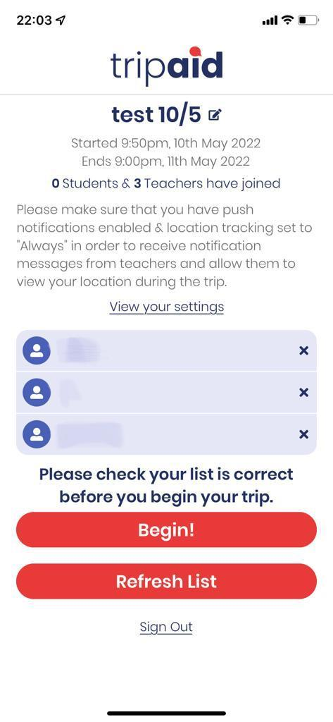
At the start of your Trip
At the designated start time for your trip the “Begin” button becomes active.
Any Teacher can press this button to make the group live.
This teacher should check the register for the group before pressing the “Begin” button.
The student and teacher codes won’t work after you press the button.

Slide 10
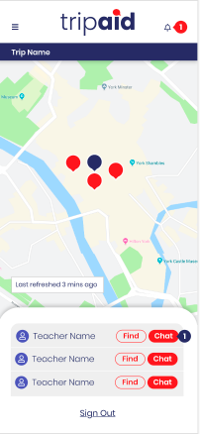
During your trip you can:
View all students and teachers on your map (Students can only see teachers)
Select anyone on the map or from the list and message them
Message multiple/all people on the trip
Edit the end time of the trip (everyone, including the school EVC will be notified of the change automatically)
Remove a student
Add a new student (this will generate a new student code, which can only be used by the named student)

Slide 11
At the end of the trip
You don’t have to do anything
The group automatically shuts down at the end time of your trip
The app will stay on your phone, so just enter a new trip code to log into your next trip!!

Slide 12
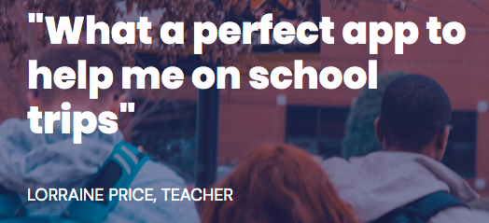

Slide 13
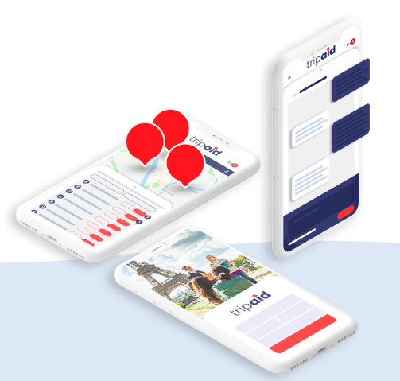
Thanks!
Any questions?
Email at:
info@tripaid.co.uk

Slide 14
EDIT IN GOOGLE SLIDES
Click on the button under the presentation preview that says "Use as Google Slides Theme".
You will get a copy of this document on your Google Drive and will be able to edit, add or delete slides.
You have to be signed in to your Google account.
EDIT IN POWERPOINT®
Click on the button under the presentation preview that says "Download as PowerPoint template". You will get a .pptx file that you can edit in PowerPoint.
Remember to download and install the fonts used in this presentation (you’ll find the links to the font files needed in the Presentation design slide)
More info on how to use this template at www.slidescarnival.com/help-use-presentation-template
This template is free to use under Creative Commons Attribution license. You can keep the Credits slide or mention SlidesCarnival and other resources used in a slide footer.

